Slide 1
树莓派平台上 Adagio 虚拟化系统的扩展与优化
郭志
2021年6月
Notes:
各位老师们好，我叫郭志，下面我来介绍我的毕业设计，树莓派平台上 Adagio 虚拟化系统的扩展与优化

Slide 2
目录 Contents
1
Background
2
Design
3
Implementation
4
Evaluation
5
Conclusion
Notes:
本展示分为五个部分，分别是相关背景、系统设计、系统实现、测试和总结这五个部分。

Slide 3
目录 Contents
1
Background
2
Design
3
Implementation
4
Evaluation
5
Conclusion
Notes:
首先，介绍本文的相关背景

Slide 4
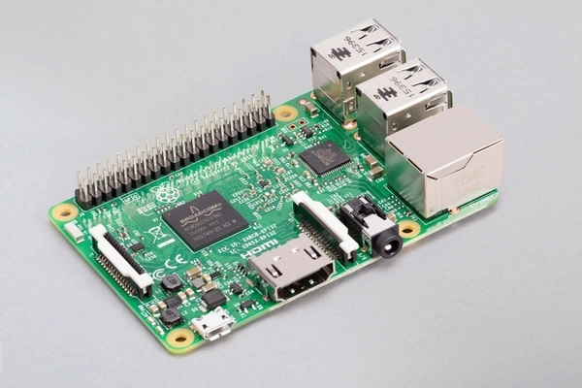

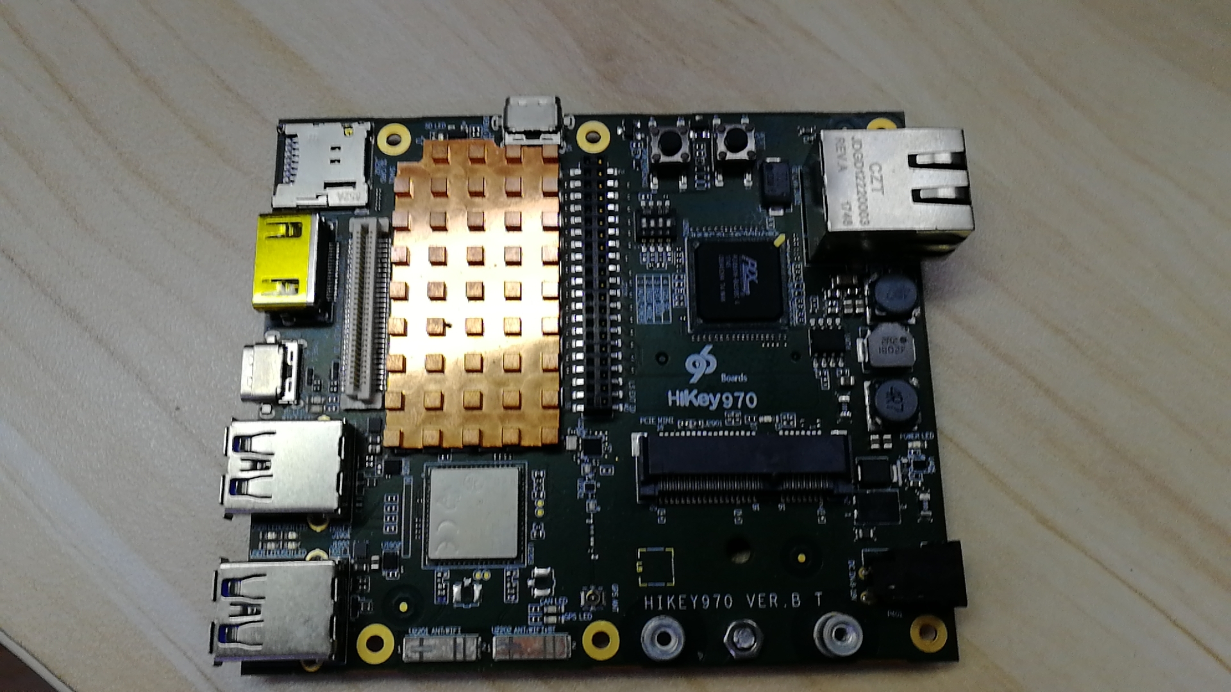
Micro-kernel OS ChCore
Developed by IPADS
The target application area of ChCore is the Internet of Things
Micro-kernel
ChCore puts the main code in user mode, each service in user-mode communicates using IPC.
Supported hardware
Raspi3B+
Hikey970
x86
Notes:
IPADS实验室面向物联网领域实现了微内核操作系统ChCore。ChCore支持三个平台，分别是树莓派3b+，Hikey970和X86。树莓派3B+和Hikey970都属于ARM架构。

Slide 5
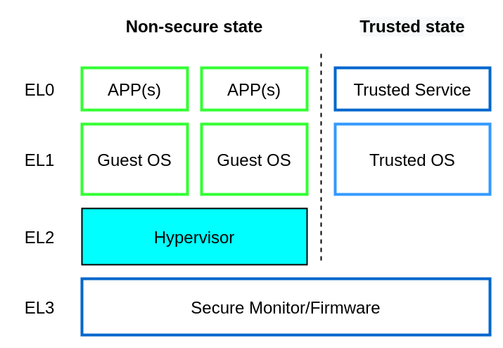
VMM Adagio
Based on ChCore
The idea of microkernel is applied, most code are existed in user mode.
For ARM
support run virtual machine in ARM platform.
Use Hardware virtualization technology of ARMv8.0
Only support Hikey970
Notes:
在ChCore上，IPADS实验室实现了虚拟化系统Adagio。Adagio是针对与ARM架构实现的，充分利用了ARMv8.0中的硬件虚拟化机制。在本工作之前，Adagio只能够运行在Hikey970上。

Slide 6
Raspberry Pi
Raspberry Pi
series of small and popular single-board computers.
Why Adagio needs Raspberry Pi
Most of ChCore’s driver are implemented in Raspberry Pi 3, including drivers of SD card, keyboard, mouse,network card,camera.Adagio needs ChCore’s driver code to provide backend driver for virtual machines.
Notes:
Raspberry Pi作为最为流行的单板机，不仅是本工作基于的硬件平台，也是ChCore支持的首要硬件平台。ChCore当前支持的驱动都是面向树莓派3b+实现的，Adagio虚拟化系统很需要能够跑在树莓派板子上。

Slide 7
Adagio needs more
Interrupt virtualization by mmio
Adagio can only virtualize interrupts by VGIC provided by specific hardware. For those hardware platforms(eg Raspi 3B+) that don’t support VGIC,Adagio will fail to virtualize interrupts for virtual machine.
Multi-VCPU
Adagio can only virtualize one VCPU for virtual machine.
Multi-VM
Adagio can only support one VM.
Notes:
除了移植到树莓派平台，Adagio还需要一系列的扩展与优化，包括通过MMIO实现中断虚拟化，支持虚拟机拥有多VCPU，支持跑多个虚拟机。本工作就是在Adagio虚拟化系统的这些需求上展开。

Slide 8
目录 Contents
1
Background
2
Overview
3
Implementation
4
Evaluation
5
Conclusion
Notes:
接下来对Adagio虚拟化系统与本工作进行整体上的介绍。

Slide 9
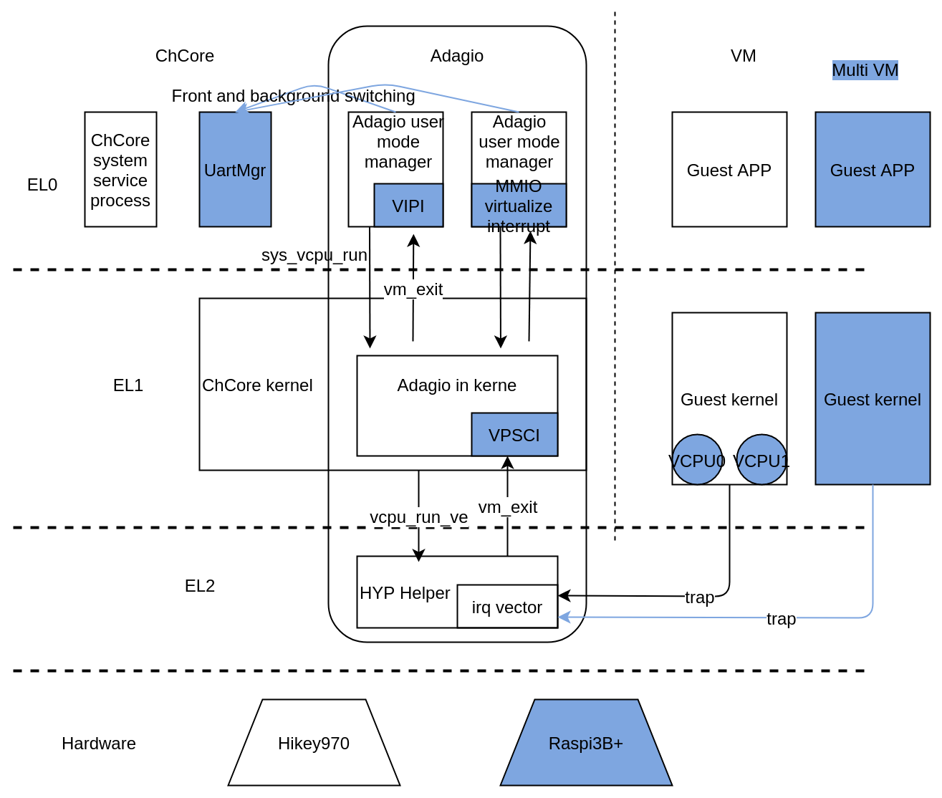
Adagio architecture
Notes:
这张图展示的是Adagio虚拟化系统的架构，浅色竖向虚线分割ChCore与虚拟机，横向深色虚线分割硬件层与软件层，以及软件层各特权级别。Adagio虚拟化系统包括位于EL2的HYP Helper以及EL1中的内核态虚拟机管理器，EL0中的用户态虚拟机管理器。蓝色图形是本工作对Adagio进行的扩展与优化。

Slide 10
Expansion and Optimization
Transplant to Raspberry Pi
Interrupt virtualization
Multi-VCPU support
Multi-VM support
Notes:
本工作对Adagio的拓展优化在四个方面展开，首先是将Adagio移植到树莓派平台上，第二个是通过MMIO的方式实现中断虚拟化，第三是让Adagio支持多个VCPU，最后是让Adagio支持多个虚拟机。

Slide 11
目录 Contents
1
Background
2
Design
3
Implementation
4
Evaluation
5
Conclusion
Notes:
接下来对这些模块进行具体介绍

Slide 12
Transplant to Raspberry Pi
merge Adagio branch to ChCore master branch.
enable and handle VTimer interrupt in Raspberry Pi 3b+.
reimplement interrupt virtualization using MMIO.
Adagio is transplanted to Raspberry Pi
Notes:
为了将Adagio移植到树莓派平台上，本工作将Adagio所在的分支合并到ChCore主线上，此时ChCore主线上与树莓派有关代码能够被我们使用；本工作使能并处理树莓派上的VTimer中断，让虚拟机能够拥有时钟中断；并通过MMIO实现了中断虚拟化。
完成这些，Adagio被移植到树莓派3B+平台

Slide 13
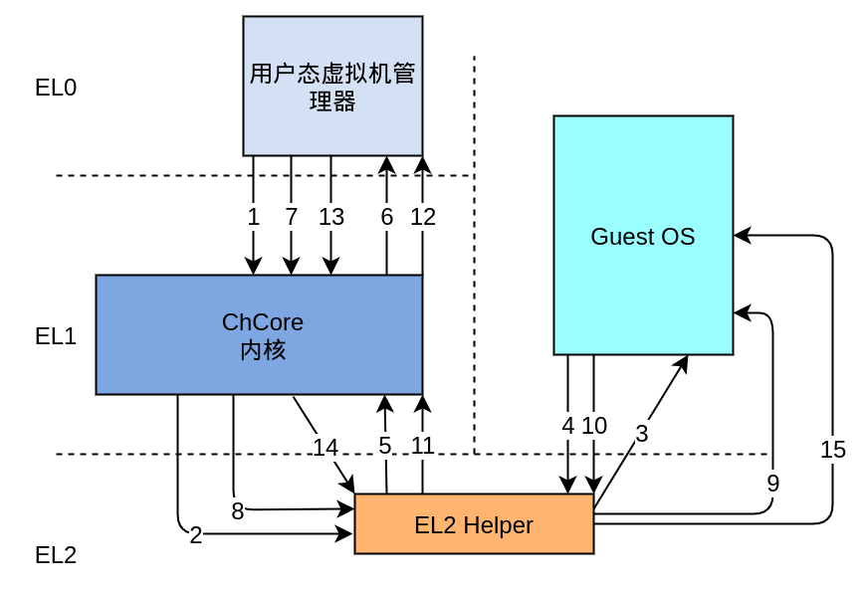
Interrupt virtualization
In GIC, os have to read GICC IAR register to ack an interrupt and write GICC EOIR register to eoi an interrupt.
In Hikey970 platform, VGIC can provide IAR and EOIR registers to vm. Ack and eoi an interrupt will not lead to vm exit.
In Raspi3B+ platform, VGIC is not existed. we have to virtualize interrupt by MMIO.
Notes:
在ARM GIC中断机制中，操作系统需要读GICC IAR寄存器来ack一个中断，写GICC_EOIR寄存器来EOI一个中断，在Hikey970中，虚拟机能够直接读写VGIC提供的硬件寄存器来完成中断的ack和eoi操作。但是树莓派3B+中并没有实现VGIC，于是我们通过MMIO来实现中断虚拟化。具体步骤如该图所示，4,10两根线表示虚拟机在读GICC IAR与写GICC EOIR寄存器时产生下陷。

Slide 14
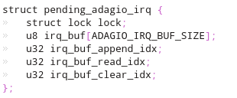
Interrupt virtualization
Through MMIO, we virtualize interrupt to virtual machines in user mode. The procedure of collect and preserve interrupts for each vm also matters.
In Adagio, there are multiple kinds of interrupts. eg VTimer, Uart, Virtual IPI. In previous Adagio version, the pending interrupt is kept in a variable, which may lead to interrupt loss. Therefore we design and implement a pending interrupt vector to preserve interrupts wait for virtualize.
Notes:
MMIO 模拟中断实现了在用户态向虚拟机模拟中断的功能。从中断触发到向虚拟机模拟该中断的过程也十分重要，它负责获取，保存所有虚拟机需要处理的中断的中断号。本文工作对该过程进行了重新实现。实现关键是通过一个队列来保存等待虚拟机处理的中断，而在之前Adagio只能为一个虚拟机保存一个待处理的中断，这会导致丢中断的情况。

Slide 15
Interrupt virtualization
Considering that the virtual machine is running when a pending interrupt is inserted into the virtual machine, the interrupt cannot be processed until the virtual machine exits.
We use physical IPI to reduce interrupt latency. This is referred to the design of KVM.
Notes:
我们使用了物理IPI来降低中断插入延迟。这是参考了KVM的设计。

Slide 16
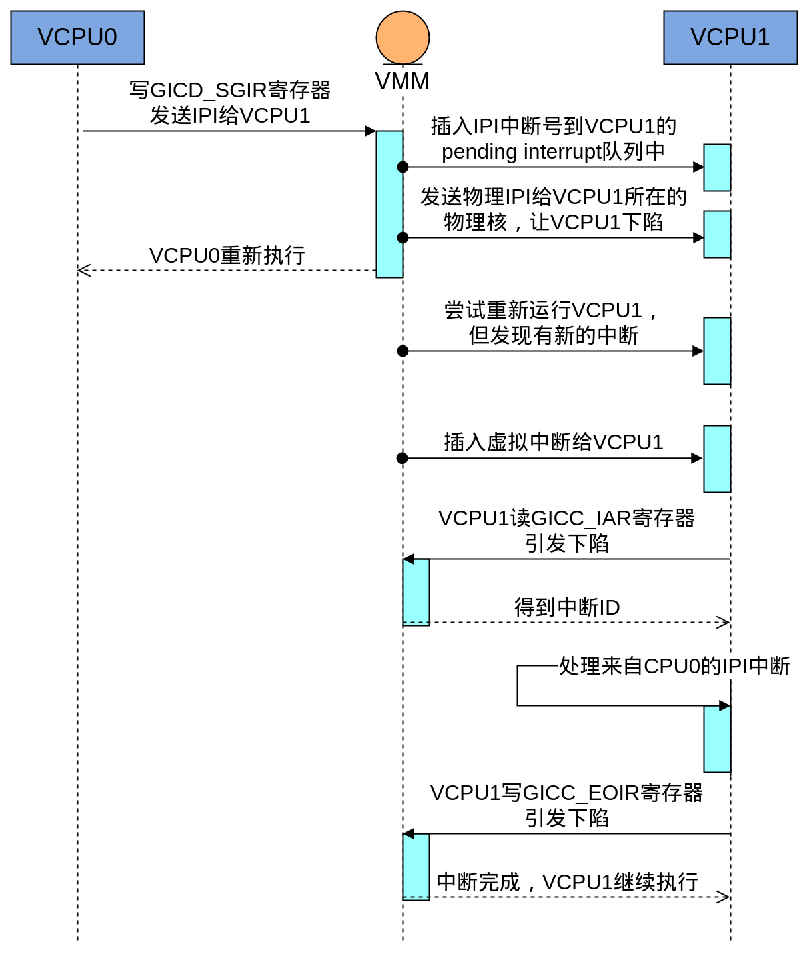
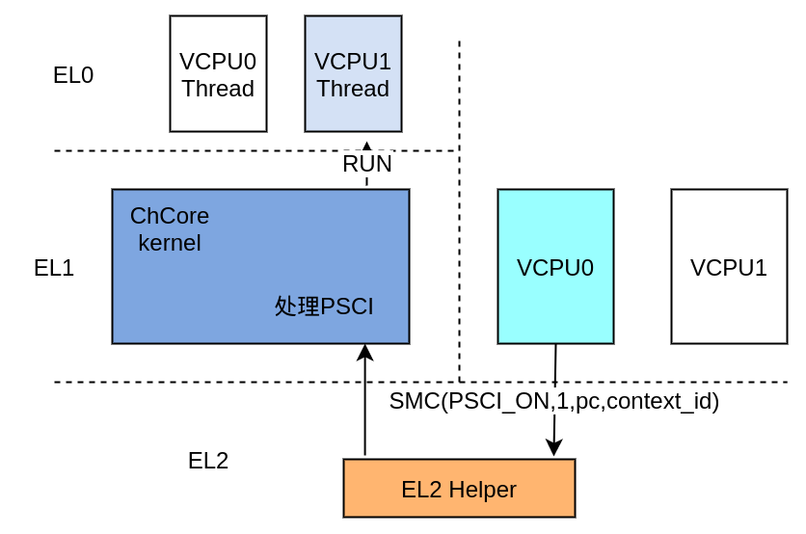
Multi-VCPU support
virtualize multiple vcpus by multiple threads
Use VMPIDR_EL2 to virtualize MPIDR_EL1 register
virtualize PSCI
virtualize IPI
Adagio is extended to multi-VCPUs
Notes:
本工作为Adagio实现了多VCPU功能，通过多个线程来模拟多个VCPU，通过VMPIDR_EL2寄存器来模拟MPIDR_EL1寄存器，通过虚拟PSCI来boot虚拟机的secondary vcpus，并实现了虚拟IPI来让虚拟机控制多个vcpu。该图展示了虚拟机VCPU0向VCPU1发送IPI的流程。

Slide 17
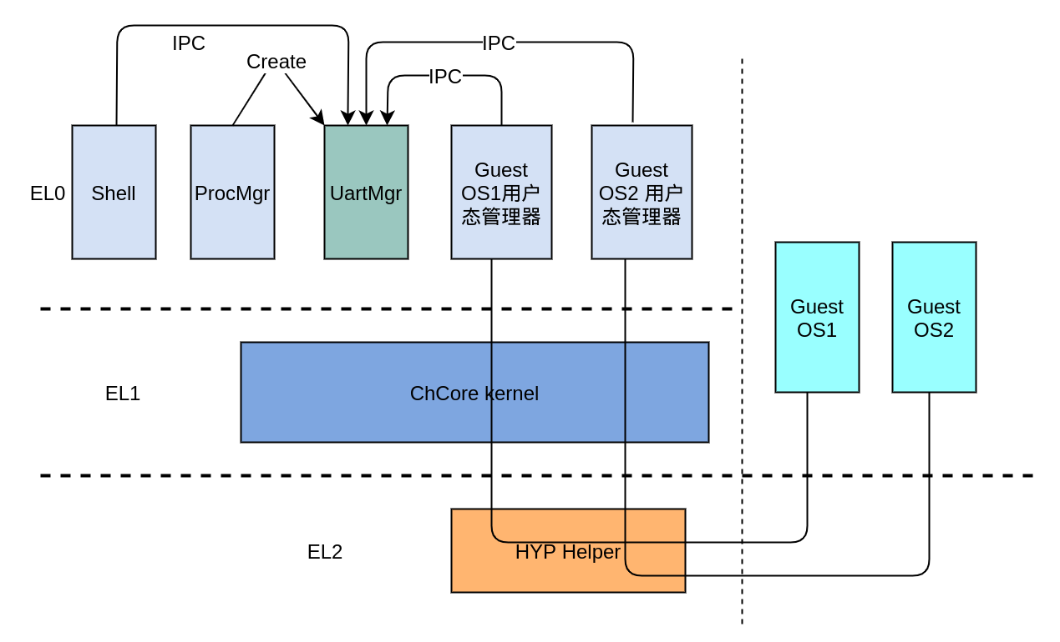
Multi-VM support
Use VMID, which is a tag in tlb. After using VMID, there is no need to flush tlb in vm enter and vm exit.
Implement UartMgr System Server in ChCore, which can deal with front and background switching.
Adagio is extended to multi-VMs
Notes:
本工作为Adagio实现了多VM功能，首先使用VMID来避免了进入虚拟机前需要的flush tlb。设计并实现了ChCore上的服务进程UartMgr，它能够实现虚拟机的前后台机制。通过它虚拟机之间能够进行切换。

Slide 18
目录 Contents
1
Background
2
Design
3
Implementation
4
Evaluation
5
Conclusion
Notes:
接下来对系统的测试阶段进行介绍

Slide 19
Functional evaluation
We made a virtual machine which can handle irq and access uart device to test interrupt virtualization.
We made a virtual machine which has multiple VCPU and can send IPI to test Multi-VCPUs support. We also use a Linux virtual machine with smp configured to test Multi-VCPUs support. The test result shows vm in Adagio can have 4 vcpus.
We implement an multiple virtual machines test framework to test Multi-VM support. The test result shows Adagio can run 8 Linux virtual machines simutaneously.
Notes:
针对本工作实现的功能，我们进行了充足的功能测试，对于中断虚拟化，我们实现了一个能够处理中断，并且读写uart设备的虚拟机，来测试中断虚拟化功能是否正常。对于多VCPU模块，我们实现了一个拥有4个CPU，能够发送IPI的虚拟机，来测试多VCPU的功能是否正常，并且我们还制作了多CPU的Linux dtb文件，结果表明Adagio支持Linux虚拟机拥有4个VCPU。对于多虚拟机模块，我们实现了一个多虚拟机测试框架，并且测试结果表明Adagio支持同时跑8个Linux虚拟机。

Slide 20
目录 Contents
1
background
2
Design
3
Implementation
4
Evaluation
5
Conclusion
Notes:
最后对本文工作进行总结

Slide 21
Conclusion
We extended and optimized Adagio
extend Adagio to Raspi3B+
extend Adagio to support multi-VCPUs
extend Adagio to support multi-VMs
optimize Adagio in Interrupt virtualization, CPU virtualization as well as Memory virtualization.
Notes:
本工作是对Adagio的扩展与优化，首先将Adagio扩展到树莓派平台上，将Adagio扩展到支持多个VCPU，将Adagio扩展到支持多个虚拟机。在中断虚拟化， CPU虚拟化，内存虚拟化都对Adagio作出了优化。

Slide 22
谢谢！
Notes:
这就是本人毕设的全部工作，谢谢！

